Slide 1
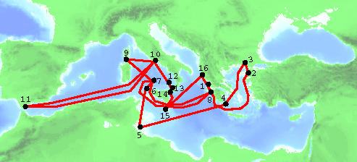
Ulysses roundtrip (an even older TSP ?)
The paper „The Optimized Odyssey“ by Martin Grötschel and Manfred Padberg is downloadable from http://www.zib.de/groetschel/pubnew/paper/groetschelpadberg2001a.pdf

Slide 2
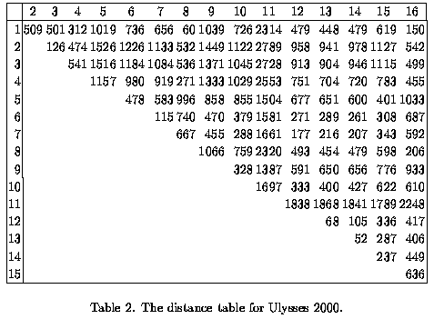
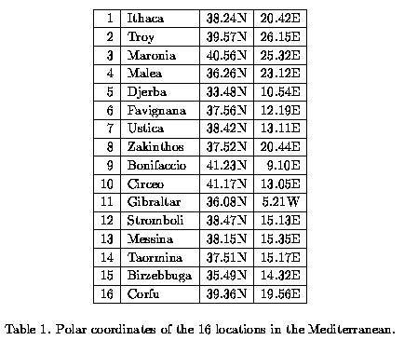
Ulysses
The distance table

Slide 3
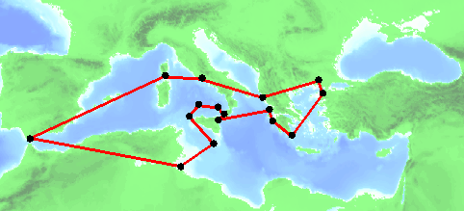
Ulysses roundtrip
optimal „Ulysses tour“

